Slide 1
Temple College
Faculty Leadership Training

Slide 2
Faculty Credentials

Slide 3
FACULTY CREDENTIALS
Southern Association of Colleges and Schools Commission on Colleges
  Guidelines -
  Comprehensive Standard 3.7.1 of the Principles of Accreditation reads as follows:
  The institution employs competent faculty members qualified to accomplish the mission and goals of the institution. When determining acceptable qualifications of its faculty, an institution gives primary consideration to the highest earned degree in the discipline. The institution also considers competence, effectiveness, and capacity, including, as appropriate, undergraduate and graduate degrees, related work experiences in the field, professional licensure and certifications, honors and awards, continuous documented excellence in teaching, or other demonstrated competencies and achievements that contribute to effective teaching and student learning outcomes. For all cases, the institution is responsible for justifying and documenting the qualifications of its faculty.

Slide 4
FACULTY CREDENTIALS
When an institution defines faculty qualifications using faculty credentials, institutions should use the following as credential guidelines:
  Faculty teaching general education courses at the undergraduate level: doctorate or master’s degree in the teaching discipline or master’s degree with a concentration in the teaching discipline (a minimum of 18 graduate semester hours in the teaching discipline).
  Faculty teaching associate degree courses designed for transfer to a baccalaureate degree: doctorate or master’s degree in the teaching discipline or master’s degree with a concentration in the teaching discipline (a minimum of 18 graduate semester hours in the teaching discipline).

Slide 5
FACULTY CREDENTIALS
  Faculty teaching associate degree courses not designed for transfer to the baccalaureate degree: bachelor’s degree in the teaching discipline, or associate’s degree and demonstrated competencies in the teaching discipline.
  Faculty teaching baccalaureate courses: doctorate or master’s degree in the teaching discipline or master’s degree with a concentration in the teaching discipline (minimum of 18 graduate semester hours in the teaching discipline).
  Faculty teaching graduate and post-baccalaureate course work: earned doctorate/terminal degree in the teaching discipline or a related discipline.
  Graduate teaching assistants: master’s in the teaching discipline or 18 graduate semester hours in the teaching discipline, direct supervision by a faculty member experienced in the teaching discipline, regular in-service training, and planned and periodic evaluations.

Slide 6
CIP Codes

Slide 7
CIP Codes
https://nces.ed.gov/ipeds/cipcode/browse.aspx?y=55
What is a CIP Code?
The Classification of Instructional Programs (CIP) provides a taxonomic scheme that supports the accurate tracking and reporting of fields of study and program completions activity. CIP was originally developed by the U.S. Department of Education's National Center for Education Statistics (NCES) in 1980, with revisions occurring in 1985, 1990, 2000, and 2010. CIP codes are designed to identify programs.

Slide 8
Approval Codes in the Lower Division Course Guide Manual (ACGM)
Courses in the ACGM have approval numbers based on CIP codes. Using CHEM 1311 General Chemistry I as an example, the 10-digit approval number for the course is 40.0501.52 03.
The first six digits of the approval number indicate subject matter and are based upon current CIP codes. Coordinating Board staff assign the last four digits. The 7th and 8th digits further delineate course content, sequence, or approval category. The 9th and 10th digits indicate the funding category.

Slide 9
Approval Codes in the Lower Division Course Guide Manual (ACGM)
  The CIP for General Chemistry is 40.0501.
  52 is the code for the content listed in the course description. The range for these numbers is typically 51 to 59.
  03 is the current state funding code for biology and physical sciences in public community and technical colleges. These codes range from 01 to 26.
40.0501. 52 03
CIP Code CB Assigned Funding Code
  Do not include the funding code on Temple College course approval forms.

Slide 10
Approval Codes in the Workforce Education Course Manual (WECM)
Approval codes for WECM courses (technical) are based on a CIP code, but may not be the same as the program CIP code.
  For instance:
  Program code for Temple College’s AAS Microcomputer Applications Technology is 11.0601, which is the CIP code for Data Entry/Microcomputer Applications, General.
  However, ITSE 1307 Introduction to C++ Programming has an approval number of 11.0201, which is the CIP code for Computer Programming/Programmer, General.

Slide 11
Types of Awards

Slide 12
Types of Awards
Academic Transfer Degrees
  AA Associate of Arts (designed for transfer to a Liberal Arts related bachelor’s degree)
  AS Associate of Science (designed for transfer to a science or math intensive bachelor’s degree)
  AAT Associate of Arts in Teaching (designed to transfer to bachelor’s degree for elementary school teachers—In Texas, generally titled Interdisciplinary Studies
Academic Transfer programs should be composed of transfer courses only. In Texas, that means the course must be listed in the ACGM. Ideally, an AA, AS, or AAT should represent the first 60 hours of a 120 hour Bachelor’s degree.

Slide 13
Types of Awards
Technical Degree (Non-transfer)
  AAS Associate of Applied Science (designed to lead directly into the workplace)
  AAS degrees may transfer to four-year schools under articulation agreements and to some BAAS degrees.
The General Education requirements (SACSCOC requirement) for an AAS are selected from the Temple College Core Courses
Discipline specific courses within the program may be chosen from the ACGM or the WECM

Slide 14
Types of Awards
Technical Awards less than a degree (Non-transfer)
  Certificate 1 (between 15-42 SCH)
  Certificate 2 (30-51 SCH)
  Advanced Technical Certificate (16-45 SCH) –provides a shortened track of 16-45 SCH for students who hold a related associate’s or bachelor’s degree
  Enhanced Skills Certificate (6-12 SCH) –provides advanced skills beyond a related AAS
  Occupational Skills Award (9-14 SCH or 144-359 CE contact hours) a sequence of courses that meet the minimum standard for program length specified by the Texas Workforce Commission for the federal Workforce Innovation and Opportunity Act (WIOA) program. OSAs do not require Coordinating Board approval and do not appear in the Board’s Workforce Education Inventory.
Requirements for all Technical Awards are described in the Guidelines for Instructional Programs (GIPWE).

Slide 15
Program Inventory

Slide 16
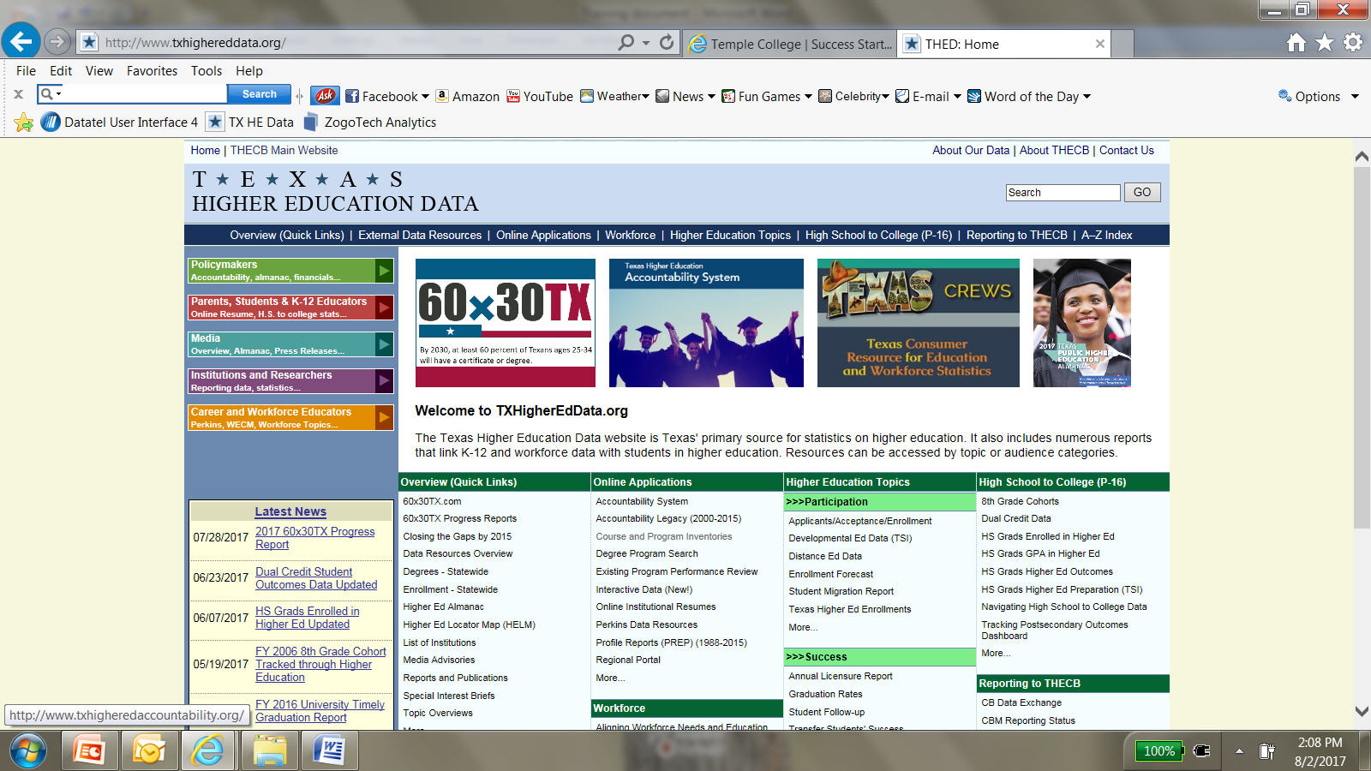
Program Inventory
http://www.txhighereddata.org/

Slide 17
More Really Important Acronyms
ACGM, WECM, GIPWE

Slide 18
ACGM
Lower Division Academic Course Guide Manual
The Lower-Division Academic Course Guide Manual (ACGM) is the official list of approved courses for general academic transfer to public universities that may be offered for state funding by public community and technical colleges in Texas.
Lecture/Lab Hours should match a sample from the Appendix A: Lecture/Lab Table
Courses Scheduled for Deletion (must check every year in the new edition)

Slide 19
WECM
Workforce Education Course Manual
The Workforce Education Course Manual (WECM) provides community and technical colleges with an inventory of pre-approved non-transferable technical courses developed in close partnership with Instructional Specialists.
Lecture – Lab Credit/Contact Hour Combinations are found in the GIPWE
Courses Scheduled for Deletion (must check every year in the new edition)

Slide 20
GIPWE
Guidelines for Instructional Programs in Workforce Education
The Guidelines for Instructional Programs in Workforce Education (GIPWE) manual provides guidelines for the design, development, operation, and evaluation of credit and non-credit workforce education programs
The processes associated with these guidelines include applications for new program approval, revisions for currently approved programs, deactivation or reactivation of programs, and closure of programs
Lecture – Lab Credit/Contact Hour Combinations Table 4.1

Slide 21
Curriculum Committee

Slide 22
Curriculum Committee
SACSCOC Requirements
  The institution demonstrates that each educational program for which academic credit is awarded is approved by the faculty and the administration (Academic program approval)
  The institution places primary responsibility for the content, quality, and effectiveness of the curriculum with its faculty (Responsibility for curriculum)
  The institution publishes policies on the responsibility and authority of faculty in academic and governance matters (Faculty role in governance)

Slide 23
Curriculum Committee
Due to the importance of the Curriculum Committee in meeting SACSCOC requirements, all curriculum changes should be brought to the curriculum committee
  Even changes that are mandates from the state through changes in the ACGM or the WECM
  This enables us to document all changes

Slide 24
Committee Proposal Submissions
Connect to the Employee Portal
Click on Documents in the top black bar
Scroll down to Committees
Open Curriculum Committee Course and Program Proposal Form
http://templejc.edu/

